Slide 1
caGrid Service Metadata
Scott Oster (Scott.Oster@osumc.edu) - Ohio State University

Slide 2
Agenda
Service Overview
Metadata Infrastructure
Common Metadata Models
Portal Metadata Examples
Metadata-Driven Query Infrastructure
Lessons Learned

Slide 3
caGrid Community Involvement
caGrid itself provides no real “data” or “analysis” to caBIG™; its the enabling infrastructure which allows the community to do so
The real “value” of the grid comes from bringing this information to the “end user”
Community members develop end user applications which consume of the resources provided by the grid

Slide 4
What is a Community Provided caGrid Service?
Silver compatible systems are exposed to the Grid as caGrid Services
caDSR models are used for all data types, and transported over the grid in a common fashion
Standardized, common pattern and mechanism for remote access
Language and implementation technology independent
Common security infrastructure for authentication and authorization
Standardized service metadata models and metadata advertisement mechanisms
Community provided service types:
Data Services
Expose data to the grid in a unified way
Analytical Services
Expose analytical operations to the grid

Slide 5
caGrid exposing Silver Systems
Object Oriented APIs and data resources are developed using Object types and information models registered in the caDSR
These “silver systems” are grid-enabled by defining a grid service interface that defines the functionality to be exposed to the grid
The grid service interface uses the same Object types as the existing system, but leverages a platform and language neutral representation (XML) of them
The grid service implementation maps service invocations to API calls or queries into the existing system

Slide 6
caGrid Metadata Infrastructure Goals
Support a strongly typed grid
Syntactic and Semantic interoperability
Programmatic!
Smooth transition from Application to Grid and back
Leverage wealth of existing metadata
Enable service Advertisement and Discovery

Slide 7
Metadata Services
Cancer Data Standards Repository (caDSR)
caBIG projects register their data models as Common Data Elements (CDEs) which are semantically harmonized and then centrally stored and managed the caDSR
The caDSR grid service provides:
Model discovery and traversal
caGrid standard metadata generation capabilities
Enterprise Vocabulary Services (EVS)
EVS is set of services and resources that address the need for controlled vocabulary
The EVS grid service provides:
Query access to the data semantics and controlled vocabulary managed by the EVS
Global Model Exchange (GME)
GME is a DNS-like data definition registry and exchange service that is responsible for storing and linking together data models in the form of XML schema.
The GME grid service provides:
Access to the authoritative structural representation of data types on the grid
Globus Information Services: Index Service
The Globus Information Services infrastructure provides a generic framework for aggregation of service metadata, a registry of running Grid services, and a dynamic data-generating and indexing node, suitable for use in a hierarchy or federation of services
The Index grid service provides:
Yellow and white pages for the grid

Slide 8
caGrid Data Description Infrastructure
Client and service APIs are object oriented, and operate over well-defined and curated data types
Objects are defined in UML and converted into ISO/IEC 11179 Administered Components, which are in turn registered in the Cancer Data Standards Repository (caDSR)
Object definitions draw from controlled terminology and vocabulary registered in the Enterprise Vocabulary Services (EVS), and their relationships are thus semantically described
XML serialization of objects adhere to XML schemas registered in the Global Model Exchange (GME)

Slide 9
Advertisement and Discovery Overview
Advertisement:
The caGrid Grid Service Owner composes service metadata describing the service to the grid and publishes it to grid. The service metadata describes properties of the grid services that caGrid users and other grid services may query.
Discovery:
A caGrid Researcher specifies search criteria describing a service. The research submits the discovery request to a discovery service, which identifies a list of services matching the criteria, and returns the list to the researcher.

Slide 10
Advertisement and Discovery Process
All services register their service location and metadata information to an Index Service
The Index Service subscribes to the standardized metadata and aggregates their contents
Clients can discover services using a discovery API which facilitates inspection of data types
Leveraging semantic information in EVS (from which service metadata is drawn), services can be discovered by the semantics of their data types

Slide 11
Service Discovery Process
Clients formulate a query over the caGrid standard metadata
Examples:
“Find me all the services from Ohio State’s Cancer Center”
“Which Analytical services take Genes as input?”
“Which Data services expose data relating to lung cancer?”
“Find me all the services with some metadata mentioning the string ‘macromolecules’”
This query is sent to the caGrid Index Service which returns the Address(es) of the services satisfying the query
The client can then further interrogate the satisfying services by asking for all of their metadata or service descriptions
Finally the client invokes the desired services as appropriate

Slide 12
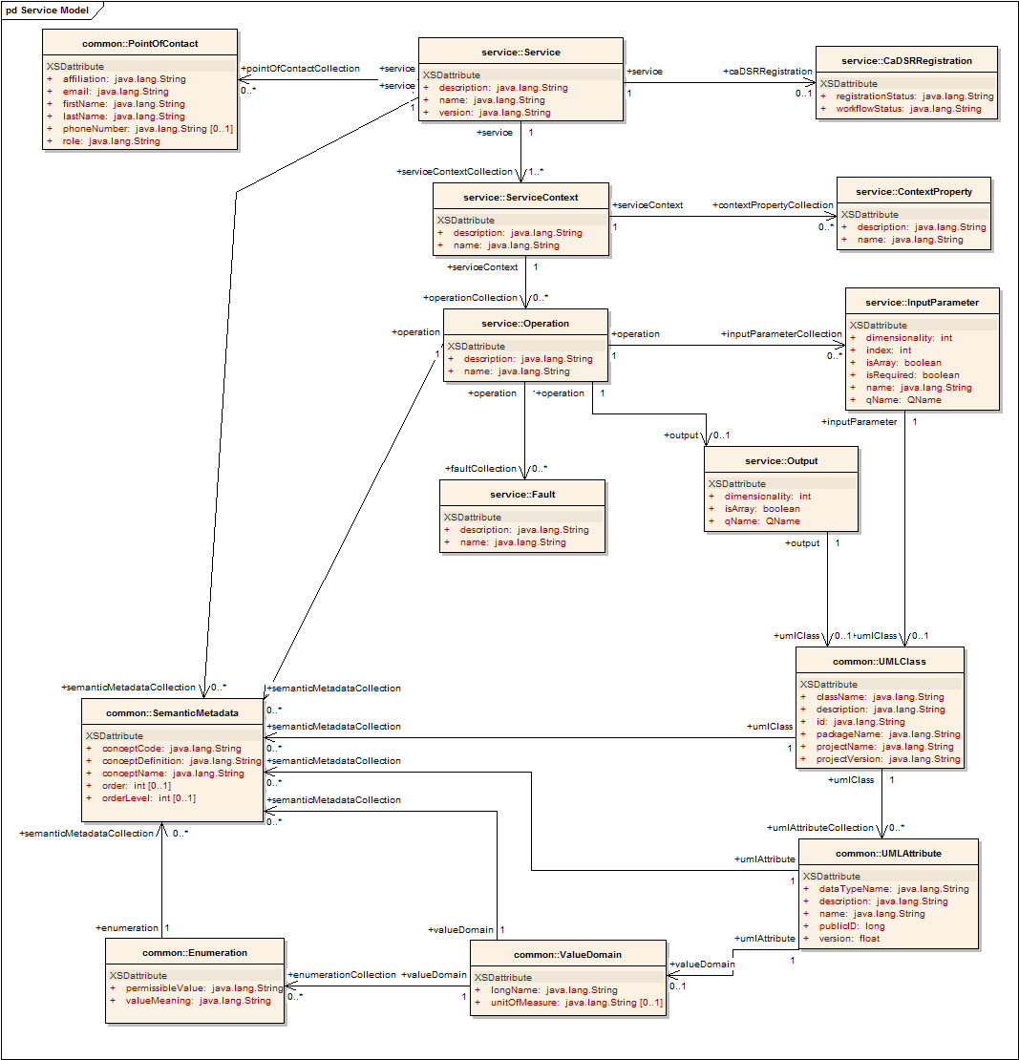
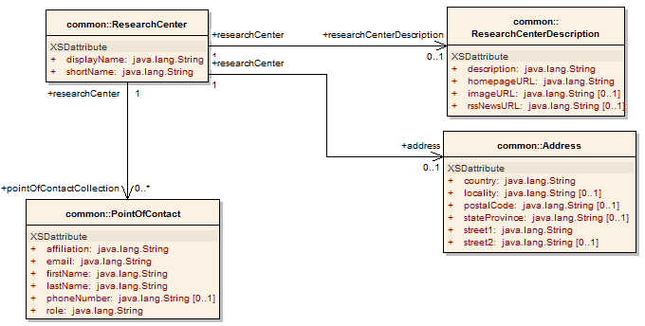
Service Metadata: Core Model
Common Service Metadata
Provided by all services
Details service’s capabilities, operations, contact information, hosting research center
Service operation’s inputs and outputs defined in terms of structure and semantics extracted from caDSR and EVS
Majority auto-generated by Introduce

Slide 13
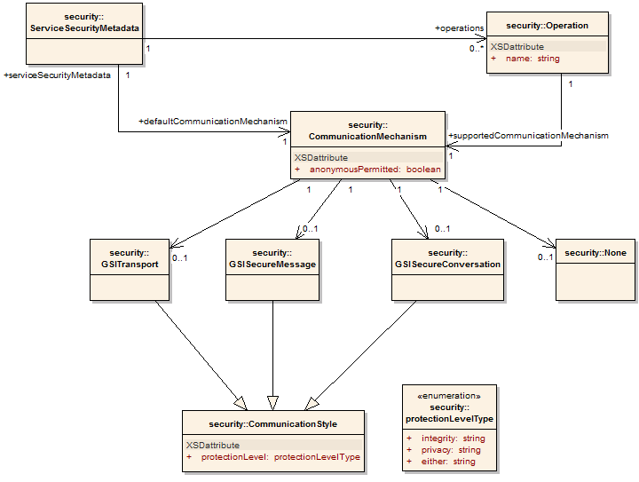
Service Metadata: Service Security
Service Security Metadata
Provided by all services
Details the service’s requirements on communication channel for each operation
Can be used by client to programmatically negotiate an acceptable means of communication
For example: Does operation X allow anonymous clients, or are credentials required?
Auto-generated by Introduce

Slide 14
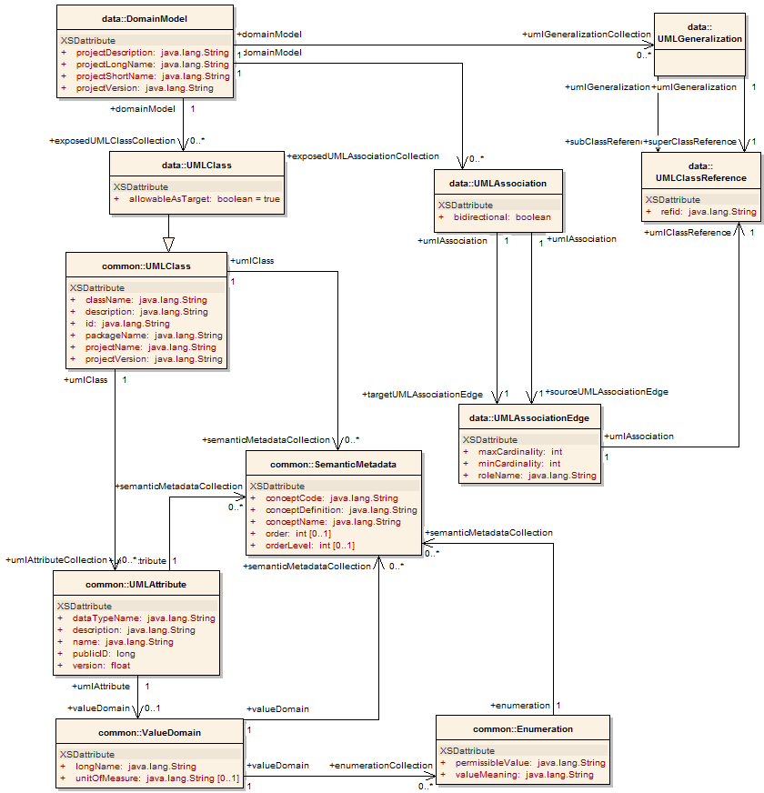
Service Metadata: Data Service
Data Service Metadata
Provided by all data services
Describes the Domain Model being exposed, in terms of a UML model linked to semantics
Provides information needed to formulate the Object-Oriented Query
As with common metadata, data types defined in terms of structure and semantics extracted from caDSR and EVS
Auto-generated by Introduce

Slide 15
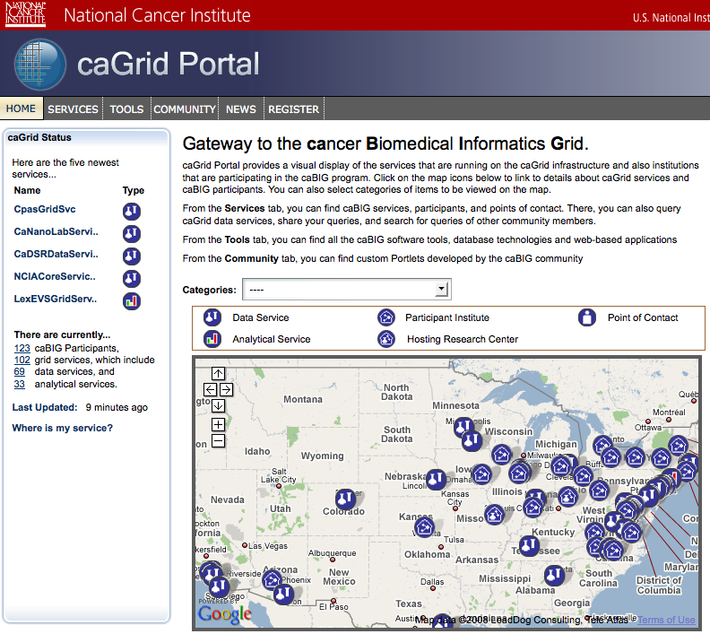
caGrid Portal: Service Map
Google Maps integration enabled by Center Information in metadata
Recent services and categorization discovered from Index Service

Slide 16
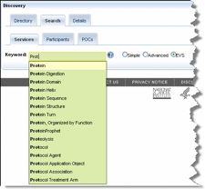
caGrid Portal: Metadata-driven Discovery
Structured discovery queries can be constructed over the metadata model
Keyword expansion with information from the controlled terminology available via the EVS

Slide 17
caGrid Portal: Service Details
Each discovered service’s metadata can be perused
Federated queries can be constructed graphically from auto-discovered potential semantic joins

Slide 18
Data Service Query Language
Specifies a target object (result) type and selects the instances which satisfy the specified properties and nested object properties
Allows path navigation
Provides logical grouping
Provides name/predicate/value filtering on properties of objects
Recursively defined
Ability to return full Objects, Set of attributes, count of results, or distinct attribute values

Slide 19
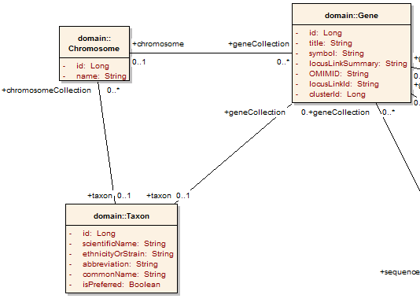
Example CQL Query
Return all Genes with a symbol beginning with BRCA and have an associated Taxon with a scientificName equal to “Homo sapiens”:
<CQLQuery xmlns="http://CQL.caBIG/1/gov.nih.nci.cagrid.CQLQuery"> <Target name="gov.nih.nci.cabio.domain.Gene"> </Target> </CQLQuery>

Slide 20
Example CQL Query
LIKE “BRCA%”
Return all Genes with a symbol beginning with BRCA and have an associated Taxon with a scientificName equal to “Homo sapiens”:
<CQLQuery xmlns="http://CQL.caBIG/1/gov.nih.nci.cagrid.CQLQuery"> <Target name="gov.nih.nci.cabio.domain.Gene"> <Attribute name="symbol" predicate="LIKE“ value="BRCA%"/> </Target> </CQLQuery>

Slide 21
Example CQL Query
LIKE “BRCA%”
Return all Genes with a symbol beginning with BRCA and have an associated Taxon with a scientificName equal to “Homo sapiens”:
<CQLQuery xmlns="http://CQL.caBIG/1/gov.nih.nci.cagrid.CQLQuery"> <Target name="gov.nih.nci.cabio.domain.Gene"> <Group logicRelation="AND"> <Attribute name="symbol" predicate="LIKE“ value="BRCA%"/> <Association roleName="taxon“ name="gov.nih.nci.cabio.domain.Taxon"> </Association> </Group> </Target> </CQLQuery>

Slide 22
Example CQL Query
LIKE “BRCA%”
Return all Genes with a symbol beginning with BRCA and have an associated Taxon with a scientificName equal to “Homo sapiens”:
<CQLQuery xmlns="http://CQL.caBIG/1/gov.nih.nci.cagrid.CQLQuery"> <Target name="gov.nih.nci.cabio.domain.Gene"> <Group logicRelation="AND"> <Attribute name="symbol" predicate="LIKE“ value="BRCA%"/> <Association roleName="taxon“ name="gov.nih.nci.cabio.domain.Taxon"> <Attribute name=“scientificName" predicate=“EQUAL_TO” value=“Homo sapiens"/> </Association> </Group> </Target> </CQLQuery>
= “Homo sapiens”

Slide 23
Federated Query Processor
Provides a mechanism to perform basic distributed aggregations and joins of queries over multiple data services
As caGrid data services all use a uniform query language, CQL, the Federated Query Infrastructure can be used to express queries over any combination of caGrid data services
Federated queries are expressed with a query language, DCQL, which is an extension to CQL to express such concepts as joins, aggregations, and target services
Implemented as a stateful grid service, queries may be executed asynchronously and results retrieved at a later time
Supports secure deployments wherein result ownership is enforced
Coupled with semantic discovery capabilities of caGrid, provides a powerful framework for data discovery, mining, and integration

Slide 24
Lessons Learned
Applications leveraging metadata will proliferate…
Therefore, having a common “base model” is important
Therefore, plan to assert its authenticity
Therefore, consider future sources of information, and how to differentiate between them
You don’t know what your users will want to do tomorrow…
Therefore, design the model with extensibility in mind
Therefore, have a plan to decide what should be incorporated into a common/standard model and what is “application specific”
In distributed systems, aggregated information is always out of date…
Therefore, only capture information which you can reliably use out of date given your scalability and performance needs

